Slide 1
Introduction to Flowchart
Nicholaus Hendrik Jeremy, S.Kom., M.Kom.

Slide 2
Learning Outcomes
LO 1 : Describe the fundamental concepts and purpose of information system analysis and design
LO 2 : Apply structured design techniques to model a system's logic and flow
LO 3 : Analyze system requirements to identify actors, processes, data, and interactions
LO 4 : Apply UML-based design artifacts to communicate a complete system solution

Slide 3
Outline
What is a Flowchart?
Standard Symbols
Reading and Drawing Basic Flowcharts

Slide 4
What is a flowchart?

Slide 5
Going back to the fundamentals
Algorithm is a set of well-defined logical steps that must be taken to perform a task.
Three main ways of presenting an algorithm are:
Descriptive
Flowchart
Pseudocode
Notes:
Reintroduce descriptive algorithm, e.g. to calculate your part when doing split bill:
Identify what you order
Total the price of your order
To include the service charge in your price, multiply it by 1.05
To include the tax, multiply the value from previous step by 1.1
Pay the grand total from the calculation of the previous step

Slide 6
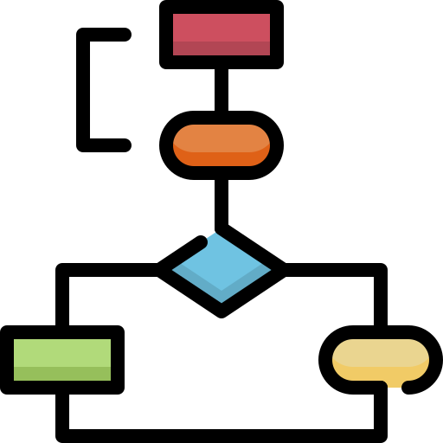
What is a flowchart?
Flowchart is a diagram that visualize each steps within the algorithm or a program.
Flowchart serves a purpose as a tool to plan, organize, analyze, and evaluate the process to complete a task.
Descriptive algorithm is good, but often it gets text-heavy. Pseudocode might get technical. This is when diagram comes into play.
In 1965 a convention to standardize the creation of sflowchart is published by American National Standards Institute (ANSI), which then is adopted in 1973 by International Standards Organizaton (ISO).

Slide 7
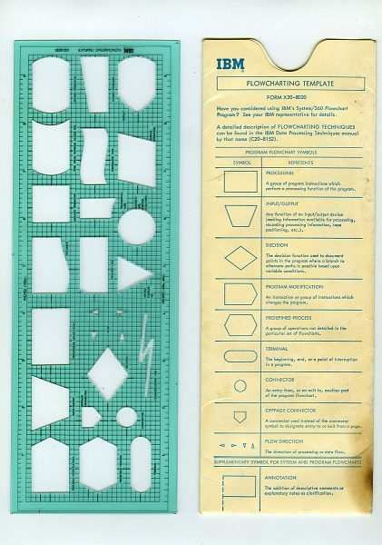
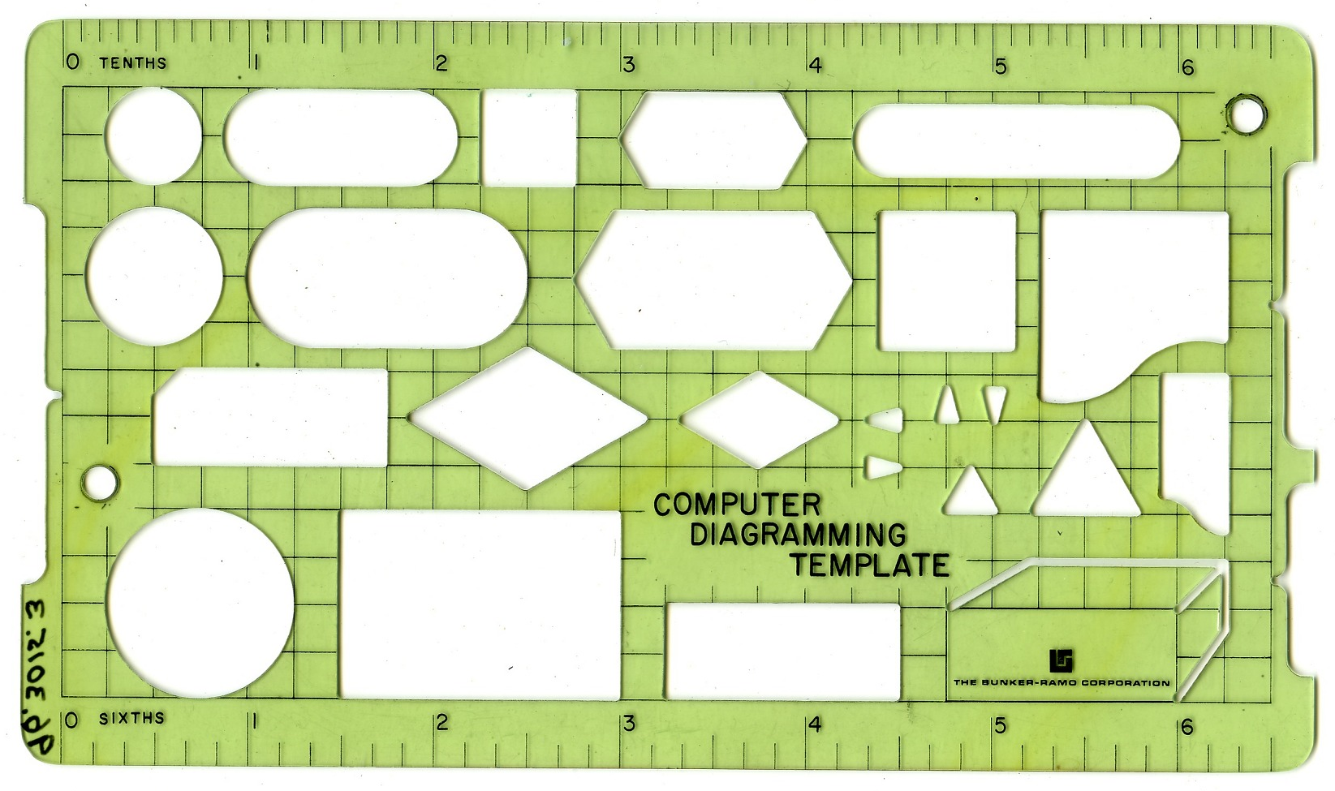
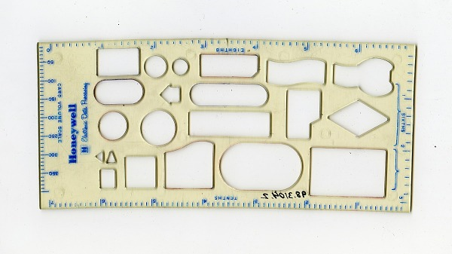
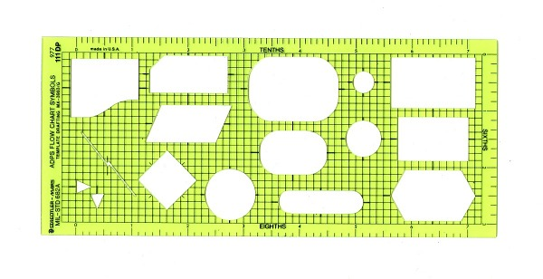
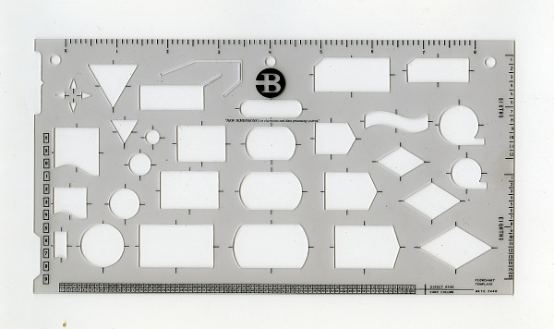
Going Back in Time
Back then, computer can’t print out complex shape, which means graphics were handmade. However, freehand drawing can get difficult when making precise shape. Several companies provide their flowcharting “template”, but one most influential template (which largely what we use to this day) comes from IBM in 1960.
Bunker-Ramo
Honeywell
Staedtler-Mars
Burrough
https://americanhistory.si.edu/collections/object/nmah_690230

Slide 8
Standard symbols

Slide 9
Refreshment = variable
Variable is a “container” to store value. A variable has name, value, position (address), and type (data type).
There are several naming convention for variable, such as camelCase, PascalCase, lower_score, or UPPER_SCORE. Stick to one convention for naming variable.
A variable can have a constant prefix (non-changeable and must be assigned a value upon declaration).
The following are the common data types:
Declaration | Meaning
Declare Real temperature | Decimal number e.g. 36.6
Declare Integer count | Whole number e.g. 5, -3
Declare String name | Text e.g. "Alice"
Declare Boolean flag | True or false only
Declare Char grade | Single character e.g. 'A'

Slide 10
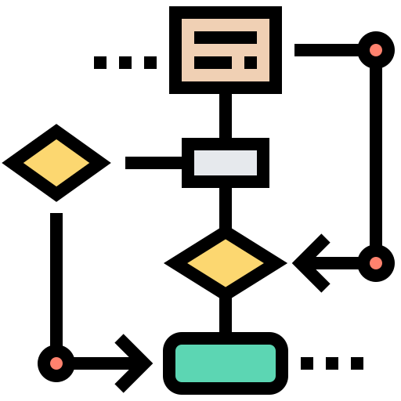
Standard Symbols
The standardization by both ANSI and ISO means that we have a set of defined shape to indicate something, one for each programming step. If each person uses different symbols to represent different things, then reading 100 flowchart will require 100 documentation. Try to internally memorize the standard symbols.

Slide 11
List of Symbols
Terminal Symbols
Input / Output Symbol
Processing Symbol
Start
Define / Set / Process
Input / Output
End
Decision Symbol
Arrow
For-Loop
Condition(s)
For var = start to end step X
Module Call Symbol
Connector
Off-Page Connector
Module Name
#
#

Slide 12
Terminal Symbols
Terminal symbols marks where a process begin and ends.
The shape is rounded rectangle (stadium / pill / obround). By some studies, oval is allowed.
A flowchart can have multiple endings (at least one) but can only have one starting point.
An arrow always goes out from start symbol and always goes into the end symbol.
Tip: Always check for terminal symbols in your flowchart.
Start / Begin
End / Stop

Slide 13
Terminal Symbols
The example here is for asking and printing name, with given descriptive algorithm:
Ask the user’s name
User input their name
Greet the user and call their name
Start
Display “What’s your name?”
Input name
Display “Hello “, name
End

Slide 14
Terminal Symbols
When you learn modular programming (Week 2), you will see that “Start” terminal is written as the module’s name, whereas the “End” is written as Return. Until then, focus on using the basic rule (you’ll revisit this again)
Main()
teamDecider(ID)
Display “Input your ID”
ID % 2 == 0
True
False
Input ID
Display “Team A”
Display “Team B”
teamDecider(ID)
Return
Return

Slide 15
Arrow
Arrow (flow line) connects the elements within the flowchart, describing how the process should go.
An arrow consists of a line and one arrowhead.
There are a lot of rules surrounding connector to ensure readability, such as:
The shape of the arrowhead must be easily recognized.
The line of the arrow must be solid* and not ambiguous.
Both ends of the connector must touch an element.
The type of arrow you use must be consistent across the flowchart.
Notes:
*dotted line is used for data flow or secondary/optional path

Slide 16
Arrow
The right and wrong way
Proper arrow ✅
Merging arrow ✅
Unconventional arrowhead❌
Two arrowheads❌
Non-solid line❌
Arrowhead is not visible❌
Squiggly line❌
Ambiguous arrow path❌
Merging arrow ✅

Slide 17
Arrow
The right and wrong way
Clean, crisp line and visible arrowhead
teamDecider(ID)
Notice the arrowhead touches the border of the element and not floating.
True
ID % 2 == 0
False
Display “Team A”
Display “Team B”
Ideally, merging the line should be done cleanly. This can be easily done on another platform.
Return

Slide 18
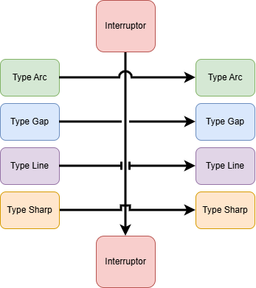
arrow
Solving the ambiguity
Ambiguous path can be inevitable especially when hand-drawing the flowchart, therefore it is advised to draw the path using line jumps / bridge. Again, be consistent on which type you’re using.
Even so, try not to use this excessively and opt for a better flowchart arrangement.
https://drawio-app.com/blog/draw-io-now-supports-line-jumps/

Slide 19
I/O Symbol
Input / Output (I/O) symbol is used to indicate when a program requests user’s input or is going to show something to the user.
I/O symbol is represented as parallelogram.
To indicate whether the symbol is input or output, a key phrase is used:
Input: Scan, Input, Retrieve
Output: Display, Show, Print, Output
When determining a phrase to be used, make sure it’s consistent.
Best practice: Separate Input and Output process
Notes:
*dotted line is used for data flow or secondary/optional path

Slide 20
I/O Symbol
Here, for example, we separate the I/O processes even though they share the same symbol.
Start
Start
Display “What’s your name?”
✅
Display “What’s your name?”
Input name
Display “Hello”, name
❌
Notice that we use Display for both our output keyword
Input name
Display “Hello “, name
End
End

Slide 21
I/O Symbol
When printing a literal, you must put it in between double quote.
There are several ways to print literal with variables, as shown below.
Scanning for multiple variables is possible using comma as separator
Display “This is a literal”
Display “Using”, var1, var2, “Separator”
Display “Using <var1> <var2> Brackets”
Display “Using $ $ Placeholders”, var1, var2
Several sources also suggest concat + or ampersand &
Several sources also suggest square bracket [] or underscode _
Input var1, var2, arr[]

Slide 22
Process Symbol
Process symbol is used to describe step involves an action, transformation, or computation.
To show process, a rectangle can be used.
See examples below on how process symbol can be used.
Declare Integer counter
Constant Real gravity = 9.81
S = “sentence”
Initializing variable
Initializing variable and value assignment
Value assignment
total = price + tax
y_pred = predict(X_train)
Arithmetic
Subroutine / function call

Slide 23
Process Symbol
It is allowed to put multiple lines within one process symbol, so long as they are related.
See examples below.
temp = a
a = b
b = temp
sub_price = split_bill(bill, “Binus”)
service_charge = sub_price * 1.05
value_added_tax = (sub_price + service_charge) * 1.1
grand_total = sub_price + service_charge + value_added_tax
Bucket swap
Split bill
Constant Integer CLIP_UPPER = 100
Declare Integer count = 0
area = length * width
perimeter = 2 * (length + width)
Geometry
Counter with upper limit const

Slide 24
Decision Symbol
If a certain process has a branching possibilities (>=2), then decision symbol must be used.
Diamond is used to represent decision. Inside, a condition must be presented.
Each line going out from the decision symbol must be labeled according to the branch value. This can be Boolean or switch case value but not condition.
Branch Label
teamDecider(ID)
True
ID % 2 == 0
False
Display “Team A”
Display “Team B”
Condition
Return

Slide 25
Decision Symbol
A condition can consist of multiple variables. See examples below.
larger > smaller
A > 0 OR B > 0
OR C > 0
Two variables used to compare to each other
Three variables used as the condition

Slide 26
Decision Symbol
It is possible that a branch does not execute anything.
The pathway from the branch can go back as well*.
Display “Input code”
tax_paid
False
Display “Incorrect code. Try again.”
True
Display “Please pay your tax”
Input code
validator(code)
False
True
Notes:
*Go back here is not using jump or goto, which is never encouraged (except working with assembly).

Slide 27
Decision Symbol
You can also “stack” decision symbol if it requires multiple decision making.
weather == “rain”
False
True
True
lazy
False
Display “Cook instant ramen”
Display “Order takeaway”
Display “Dine out”

Slide 28
Decision Symbol
Creating switch case is as easy as increasing the number of branches. Be sure to include Default (when variable does not contain the coded cases)
team_name
For example, team_name == ‘F’ will go to Default.
‘A’
‘B’
‘C’
Default
id_head = “001”
id_head = “002”
id_head = “003”
id_head = “000”

Slide 29
Going back to the asterisk
It is possible for decision symbol to have a branch path that goes back. This have two implications:
An intermediate process or input is utilized to determine the decision output.
The decision symbol will be revisited until the other branch is accessed.
For example, when you are putting an authentication code, the code will be checked if it’s correct. If it’s not correct, then you must input it again until you input the correct one.
This means routing back is a very specific case and must be used with care.
Display “Input code”
Input code
Display “Code incorrect”
validator(code)
False
True

Slide 30
Iteration
To achieve this action, you must consider three things:
What am I observing?
When do I stop observing?
How to change the thing I’m observing?
You can, of course, observe more than one thing.

Slide 31
Iteration
Let’s translate this to the most common example: eating food.
What am I observing : The food
When do I stop observing : When the food is all eaten
How to change the thing I’m observing? : Reduce the amount of food by eating
Once you have planned the steps, you can arrange the flowchart. Use all the steps to help you.

Slide 32
Iteration
Start
Get food
How to change the thing I’m observing : Reduce the amount of food by eating
What am I observing : The food
Take part of the food out
Put the food into the mouth
Is there still food?
True
When do I stop observing : When the food is all eaten
False
End

Slide 33
Iteration
See another example using roguelike games, having lives and target score:
What am I observing? : score and lives
When do I stop observing? : when score exceeds or equal to target OR there is still lives
How to change the thing I’m observing? : increase the score OR reduce the lives

Slide 34
Iteration
Here’s the example of observing two things (using conjunction)
When do I stop observing : when score exceeds or equal to target OR no lives left
What am I observing : score and lives
Start
True
score < target
AND lives > 0
Declare Integer score = 0
Declare Integer lives = 3
Declare Constant Integer target = 10
False
How to change the thing I’m observing : Increase the score
How to change the thing I’m observing : Reduce the lives
Input user_turn
score >= target
valid(user_turn)
True
False
True
False
Display “WIN!”
Display “LOSE”
score = score + 1
lives = lives - 1
End

Slide 35
Iteration
Start
Start
You can set the process after the condition…
Get food
Get food
Take part of the food out
Put the food into the mouth
Take part of the food out
Put the food into the mouth
Is there still food?
Is there still food?
True
True
… or before the condition
False
False
End
End
Notes:
This is when the concept of “while do” and “do while” is introduced.

Slide 36


Iteration
Nevertheless, it is CRITICAL for the process to exist. If the same flowchart is created without the process, then we can think of it as just letting the food there without eating. Since we will always check if the food still there and it always will be there, we will get stuck in an infinite loop. This is the one of the most common error in programming.
Get food
Get food
Take part of the food out
Put the food into the mouth
Is there still food?
Is there still food?
True
True
False
False
❌

Slide 37
Iteration
Always think about the logic to know when to place the process:
Password always starts empty, so placing the process BEFORE condition is correct.
Connecting to the internet is always an “attempt”, because there is not always an internet connection. Therefore, placing the process AFTER condition is correct.
When reading a book, it is guaranteed to have a text. Therefore, placing the process BEFORE condition is correct.
However, when reading a text file, it is possible for the file to be empty. Therefore, placing the process AFTER condition is correct.
Notes:
Encourage the students to think of another case. Also, ask the students to create the flowchart for each case to ensure understanding.

Slide 38
iteration
Often you will work with counting, for example working on sequence, creating multiplication table, string processing, array traversal, and so on. Here, for example, is a flowchart to print out number from 1 to 10.
Declare var = 1
var = var + 1
var <= 10
Display var
False
True
False
Notes:
Ask the student to identify the three key points:
What am I observing?
When do I stop observing?
How to change the thing I’m observing?

Slide 39
For-Loop symbol
If we know the observed variable is guaranteed to change, then we can simplify the iteration process into a single symbol : For-Loop.
For-Loop is practical because all three steps we have talked about can be condensed into one symbol, reducing the clutter in our flowchart.
The structure is as follows:
For variable = starting_value To max_value [Step step_value]
[] = optional, default to 1
Declare var
For var = 1 to 10
Display var
Next
Exit

Slide 40
For-Loop symbol
Observe the characteristics.
You still have to declare the observed variable
The for-loop consists of:
what variable is observed (var)
when to stop (when the var value is greater than 10)
and how to change the observed thing (increase the value of var by 1)
Declare var
The connector must connect back to the for-loop symbol instead of merging
For var = 1 to 10
Display var
Next
Exit
The label is now fixed to “Next” (for-loop continues) and “Exit” (for-loop is done)

Slide 41
For-Loop symbol
Declare no_left, no_right, result
You can also stack the for-loop
For no_left = 1 to 5
Next
For no_right = 1 to 5
Next
result = no_left * no_right
Exit
Exit
Display no_left, “ * “, no_right, “ = “, result
The loop-back path can go either above or below the for-loop symbol, so long as it routes back to the symbol

Slide 42
iteration
Do note, however, not all iteration can be converted to for-loop.
For-loop guarantees the observed variable to change constantly.
If the observed variable is non-incremental, then it is impossible to convert it to for-loop.
For example:
You can’t iterate over password input from the user.
When playing a health-based game, you don’t usually iterate over health count because each turn does not guarantee health loss.
Reading arbitrary files with no constrained file size means the file length can vary; therefore hard-rule is not possible.
Notes:
In practice, converting while() to for() is possible, although tricky, up to two incremental possibility (using ternary operation).
If the structure of while is as follows:
input x
while( x < 10){
//statements
x += x%2 == 0? 3 : -1;
}
Then the conversion to for will be as follows:
input x
for(x ; x < 10 ; x += x%2 == 0? 3 : -1){
//statements
}
If there are more than two incremental values possible to execute, while possible, it’s better to leave the third parameter of for() empty and use if-else statement within the for-loop for better clarity.

Slide 43
Connector
When the space is barely enough, connector can help.
There are two kind of connector – on-page connector (usually just called connector) and off-page connector.
On-Page Connector
Off-Page Connector
#
#

Slide 44
Connector
This comes from the other A connector
Use connector to flow to another point on the same page. A circle is drawn with label written inside.
The label can be a letter or number, and a page can have multiple connector.
A connector label is page-scoped. Meaning, the same label may be reused on a different page without conflict, as each label is bound to its own page.
Start
A
B
Display “What’s your name?”
Display “Hello “, name
Input age
Input name
Display “You are <age> years old”
Display “Tell me your age”
A
B
End
Go to the other A connector

Slide 45
Connector
This flow comes from page 1
Use off-page connector to flow another point onto a different page. A pentagon is used to describe an off-page connector.
The label can be a letter or number, and a page can have multiple off-page connector.
In contrast, an off-page connector label is document-scoped.
Start
1
Display “What’s your name?”
Display “Hello “, name
Input name
Display “Tell me your age”
2
End
Go to page 2
Page 1
Page 2

Slide 46
Connector
Careful when labelling the connector. Labeling on-page and off-page connector has a different rule.
A
Start
1
Display “What’s your name?”
Display “Hello “, name
Navigate the on-page connector by looking for the same label within the same page
Input age
Input name
Display “Tell me your age”
Display “You are <age> years old”
A
2
End
Navigate the on-page connector by flipping the page within the document
Page 1
Page 2

Slide 47
Connector
Best Practice
Try not to use on-page connector at all. Instead, redesign the flow. A good flow rarely use on-page connector. On-page connector should be used as a last resort.
Make sure the connector comes in pair. A single connector means nothing and causes confusion.
Keep labelling consistent. Page number is inherently number, so using number for off-page connector can be more intuitive than using letter. This leaves using letter to label the on-page connector.

Slide 48
Reading and drawing the flowchart

Slide 49
Reading the flowchart
Always find the “start” terminal. Every reading starts there, never anywhere else.
Follow the arrow carefully. While it is usual for the path to go top-to-bottom, as we have seen before there are occasion when an arrow goes back, or when connector is involved.
Understand the intent of each symbol. Ask “why” and try to answer the question yourself to deepen your understanding of the flowchart.
Observe the decision symbol with utmost care. A decision symbol can be solely for decision but also can be for an iteration. Each branch have different label which also must be taken into consideration when reading.
Track variables’ value. You can do this mentally, or better, create a note using other paper. Hand-tracing flowchart is useful to have a picture of the flowchart’s intent.
Always end at the “end” terminal. If the flowchart you’re reading ends somewhere else, it’s a faulty flowchart.

Slide 50
Drawing the flowchart
Analyze the problem fully before drawing. Plan out the algorithm, identify the variables and processes are needed, and so on.
Always starts and ends with terminal symbol. This is a non-negotiable rule.
Always be consistent. Decide on one characteristic you’re using and stick with it the entire time. This includes but not limited to keywords, naming convention, arrowhead style, printing style, and line gap type.
When drawing flowchart, use the “reading path”. When proceeding, flow down or to the right. When going back, flow up or left.
Always label every decision branch. Even when the option is only true or false, write both. Never leave room for reader’s interpretation.
When hand-drawing the flowchart, use pencil first. This is to prevent poor layout which ends up in excessive use of line gap and connector.
Hand-trace your flowchart. This way you will recognize the flowchart’s error if there’s any.

Slide 51
A little note
There are plenty of theory books and software out there, each with their own flowchart symbol and technique. When using software, especially, you will find a slight difference on representing things. Do not be confused and stick to the convention.
One of the recommended tool is Flowgorithm, which was built using the same theory this slide uses. There are learning curves, however, and stricter design policy.
Another recommended tools to create flowchart are Draw.io (diagrams.net), Lucidchart, Visual Paradigm, and Miro.

Slide 52
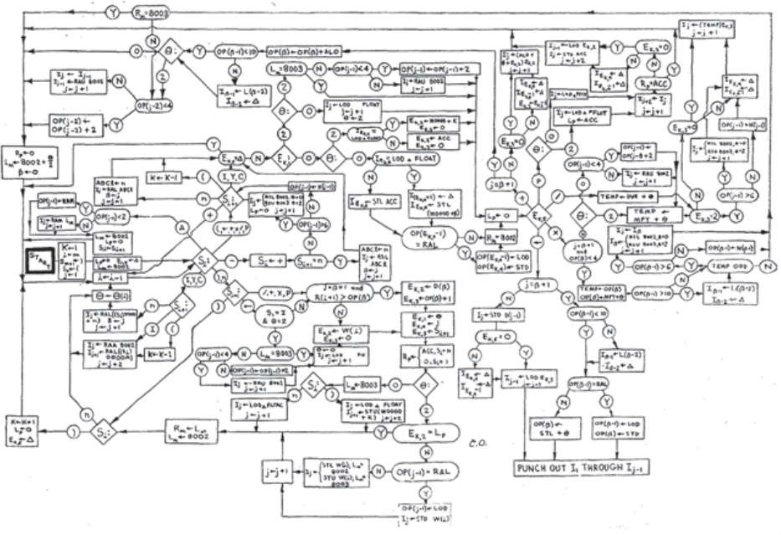
FOOD FOR THOUGHT
It is rarely seen for flowchart to describe every step within a program or task to a minute detail. Although visual representation often provide clarity to the viewer even to the non-technical, when the complexity rises, the visual can get cluttered quickly. The popularity of high-level languages also makes it faster to simply code than to diagram first. Constant change to the code also requires changing the flowchart as well.
Nowadays, the usage of flowchart has shifted from representing low-level, logical steps into high-level design architecture or plans.
Published flowchart of Runcible by Don Knuth (https://tjsawyer.com/B205proglang.php)

Slide 53
Exercise
Draw flowchart for the following problems
Calculate the area and volume and perimeter of a cuboid (rectangular block). User will input the length, width, and height.
User inputs a positive-value year. Determine whether that year is leap year or not.
Calculate the factorial of N. User will input N.
Given a list of student’s score, determine the number of students that pass and fail. The threshold for passing is 65 (65 is also a passing score).

Slide 54
References
Gaddis, T. (2022). Starting Out with Programming Logic and Design 6th Edition.
ISBN: 9780137602018 / 9780137602148

Slide 55
Thank you

